Slide 1


Implementation Of Chatbot Using NLP
Done by:
E Bhanu Prakash Reddy
BTech - CSE
Sphoorthy Enginnering College

Slide 2

Learning Objectives
Understand Natural Language Processing (NLP)
Develop chatbot capabilities
Implement AI-driven conversation systems
Enhance customer support automation
GOAL
To develop an intelligent chatbot using NLP techniques for efficient human-computer interaction.
GOAL
Source :
www.freepik.com/

Slide 3
Tools and Technology used
Programming Language: Python NLP
Libraries: NLTK, spa Cy
Machine Learning Framework: TensorFlowWeb ,logistic regression
Frameworks: Flask (Backend), React.js (Frontend)

Slide 4
Methodology
Data Collection and Preprocessing
Intent Recognition using NLP models
Training Machine Learning Model
Deploying the Chatbot using Flask and React.js

Slide 5
Problem Statement:
Traditional customer support systems are slow and inefficient. AI-driven chatbots can enhance response time and provide automated assistance.

Slide 6
Solution:
An NLP-based chatbot that understands user queries and provides relevant responses in real-time.

Slide 7
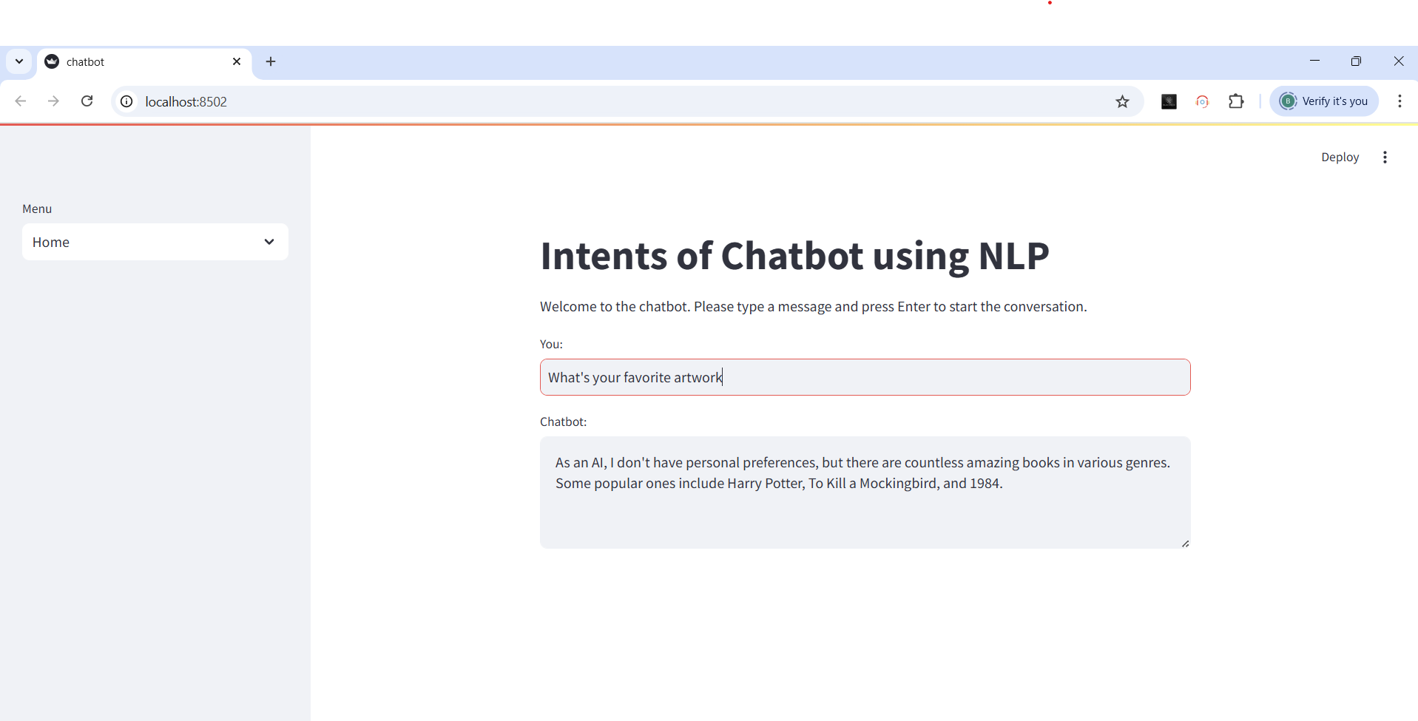
Screenshot of Output:

Slide 8
Conclusion:
The implemented chatbot demonstrates how NLP can be effectively used to automate customer support and enhance user engagement.

